Slide 1




Climate Change and
Wine Production
Group 1
Amanda Derdiger, Andrew Koller, Mustafa Ayter, Lindsay McFayden

Slide 2
Research Questions
Does climate change affect global wine production?
Is there a correlation between average temperature and wine production?
Is there a correlation between rising temperatures and the creation of new wine industries in regions previously unfit for wine production?
Which geographical regions can expect to see an increase in wine production and which regions can expect to see a decrease in wine production given the expected rise in temperature?

Slide 3



Datasets
Wine Production
Crops and livestock products database from the Food and Agriculture Organization of the United Nations (FAO).
Dataset / API used to measure wine production by country by year.
Temperature
Global Historical Climatology Network - Daily (GHCN-Daily), Version 3 from the NOAA National Climatic Data Center.
Dataset / API used to measure daily weather temperature indices by country by year.
Global Temperature Anomaly
GISS Surface Temperature Analysis from the NASA Goddard Institute for Space Studies.
Index used to find global annual mean temperature change.
Notes:
Lindsay -

Slide 4
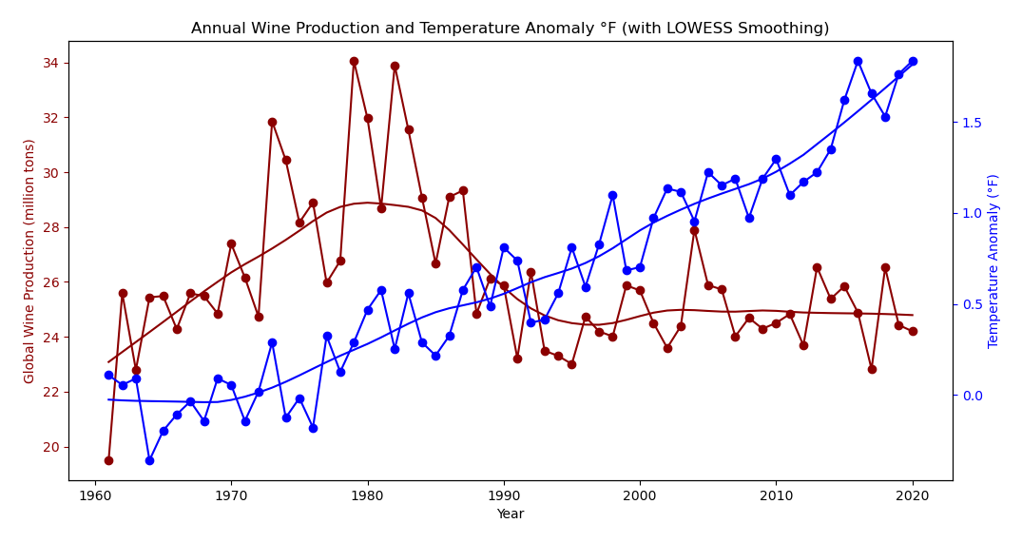
Global temperatures are rising. Does climate change affect global wine production?
Earth’s temperature has risen by 2° F since 1880 (an average of 0.14° F per decade).
The 21st century is marked by slow growth in global wine production.
A 3.6° F rise in temperature could shrink wine-growing regions by more than half. (National Academy of Sciences, 2020)
Notes:
Lindsay:
The NASA Goddard Institute for Space Studies Land-ocean temperature index averages annual land and ocean temperatures between 1880 to present.
The temperature anomaly is a way to visualize global temperature change while taking into account Earth’s varying regional climates. A 2 degree F increase in temperature is a significant change regardless of climate region.
Temperature anomaly is calculated by taking the difference between annual temperatures and the average temperature of the baseline period,1951-1980.
LOWESS (Locally Weighted Scatterplot Smoothing) is used to reveal long-term trends by smoothing out short-term fluctuations.
The Global Temperature Anomaly line graph illustrates Earth’s temperatures are rising.

Slide 5
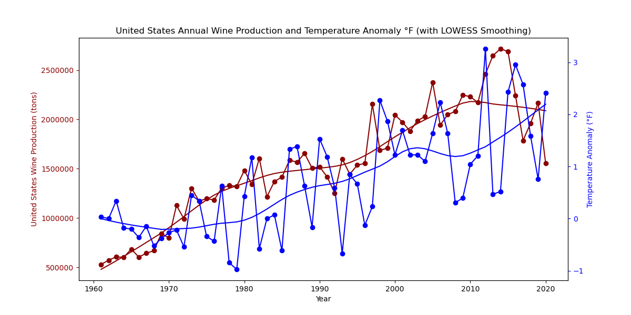
United States.
Notes:
Lindsay-

Slide 6
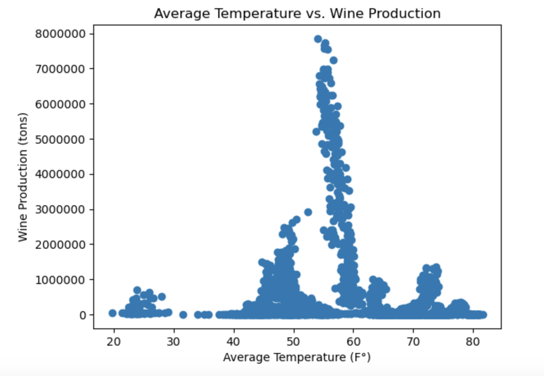
Is there a correlation between rising average temperatures and wine production?
Notes:
Wine can be grown across a wide variety of temperatures
However, the majority is grown in countries with an average temperature around 60 F

Slide 7
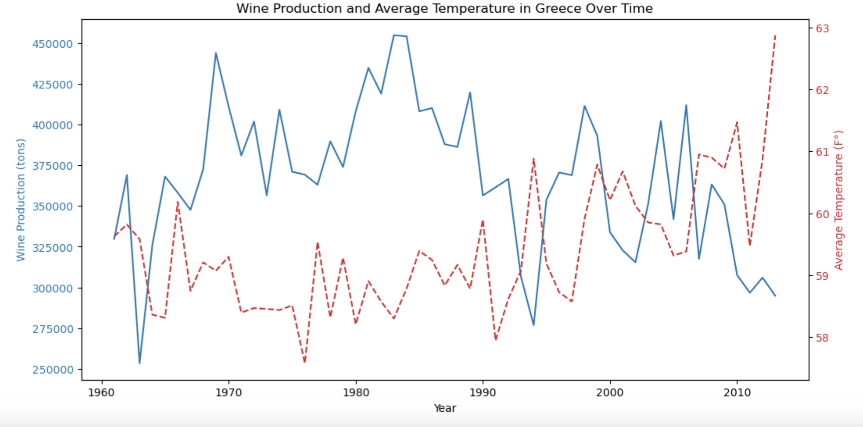
Greece
Notes:
We analyzed over 100 countries to determine if a correlation exists between rising temperatures and wine production. While we did see weak to moderate correlation in some countries, overall we determined that a statistically significant correlation cannot be concluded with our current data sets.
Greece is an example where we see a weak to moderate correlation, with an r-value of -.5. On the top graph, we see that as temperatures have increased, especially over the last decade, wine production has decreased.
South Africa is an example where we see a weak correlation, with an r-value of .39. Temperatures here have fluctuated, but overtime have not increased or decreased significantly. However, wine production has been increasing consistently since 1980. This indicates that there are other factors as play influencing wine production.

Slide 8
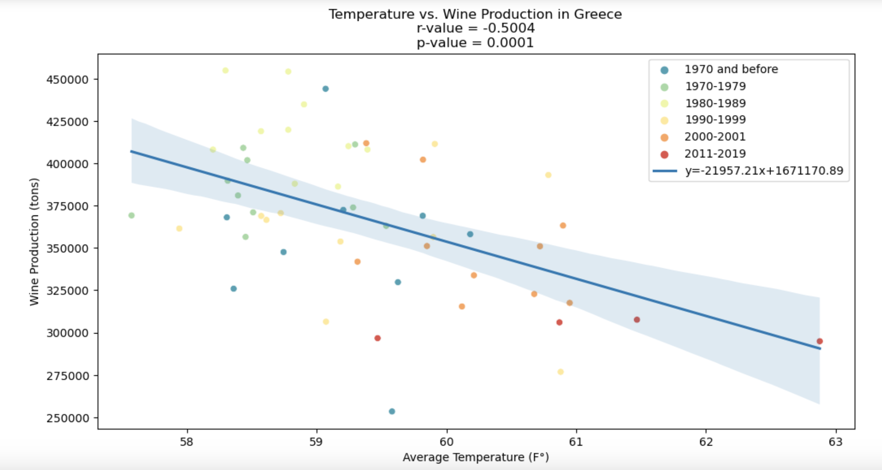
Greece
Notes:
We analyzed over 100 countries to determine if a correlation exists between rising temperatures and wine production. While we did see weak to moderate correlation in some countries, overall we determined that a statistically significant correlation cannot be concluded with our current data sets.
Greece is an example where we see a weak to moderate correlation, with an r-value of -.5. On the top graph, we see that as temperatures have increased, especially over the last decade, wine production has decreased.
South Africa is an example where we see a weak correlation, with an r-value of .39. Temperatures here have fluctuated, but overtime have not increased or decreased significantly. However, wine production has been increasing consistently since 1980. This indicates that there are other factors as play influencing wine production.

Slide 9
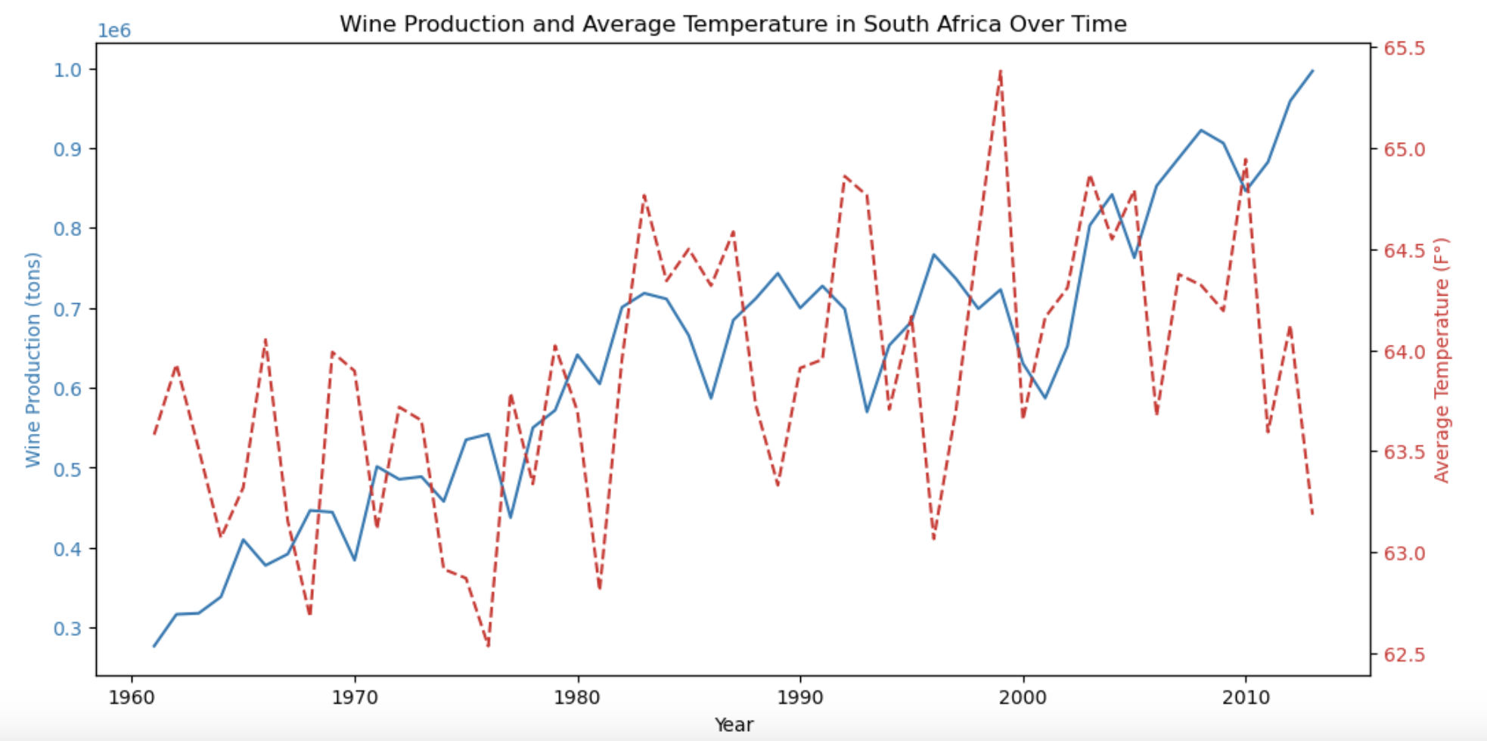
South Africa
Notes:
We analyzed over 100 countries to determine if a correlation exists between rising temperatures and wine production. While we did see weak to moderate correlation in some countries, overall we determined that a statistically significant correlation cannot be concluded with our current data sets.
Greece is an example where we see a weak to moderate correlation, with an r-value of -.5. On the top graph, we see that as temperatures have increased, especially over the last decade, wine production has decreased.
South Africa is an example where we see a weak correlation, with an r-value of .39. Temperatures here have fluctuated, but overtime have not increased or decreased significantly. However, wine production has been increasing consistently since 1980. This indicates that there are other factors as play influencing wine production.

Slide 10
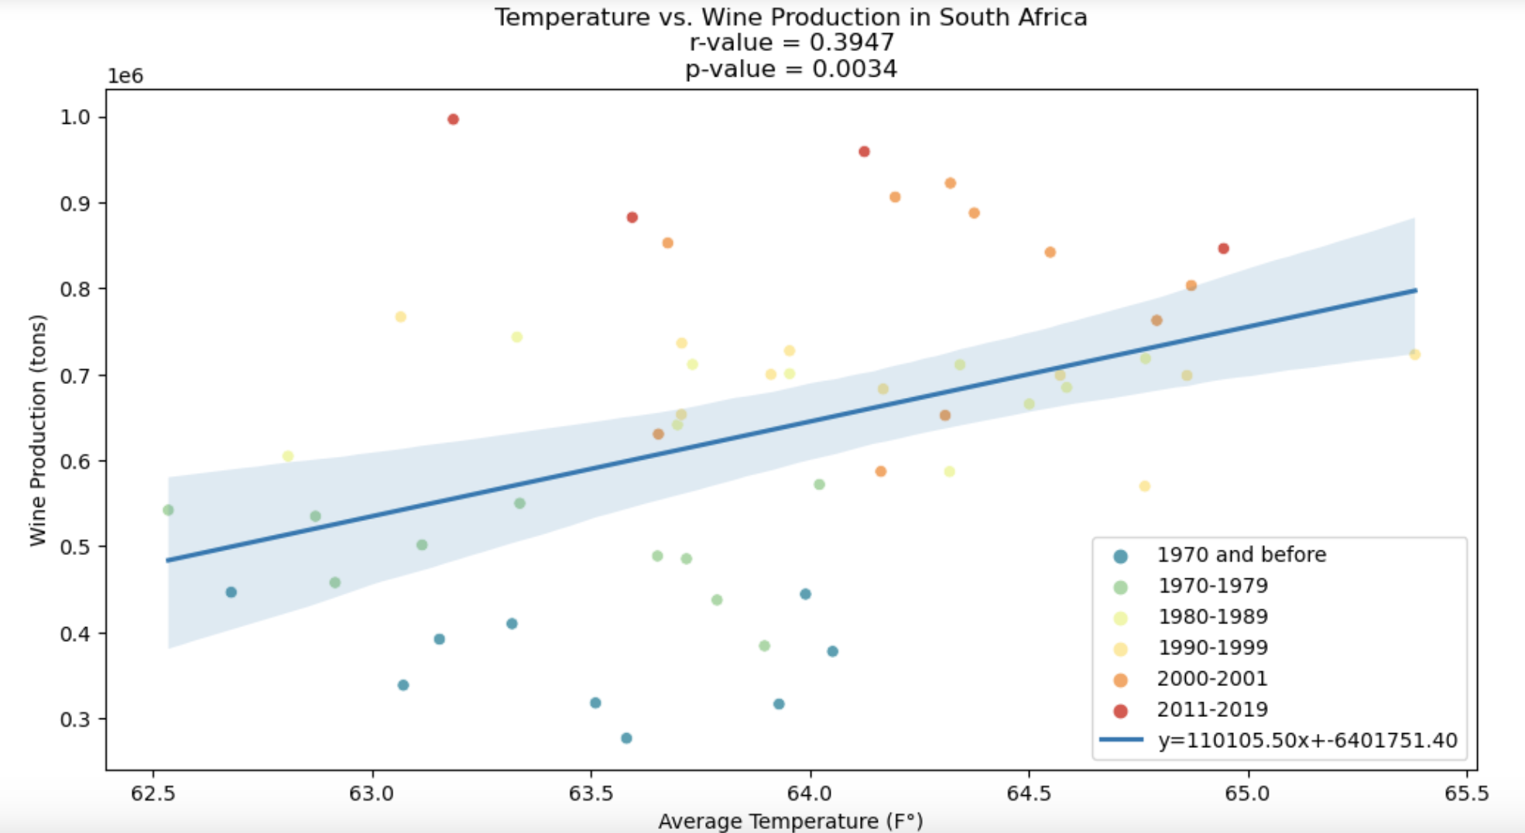
South Africa
Notes:
We analyzed over 100 countries to determine if a correlation exists between rising temperatures and wine production. While we did see weak to moderate correlation in some countries, overall we determined that a statistically significant correlation cannot be concluded with our current data sets.
Greece is an example where we see a weak to moderate correlation, with an r-value of -.5. On the top graph, we see that as temperatures have increased, especially over the last decade, wine production has decreased.
South Africa is an example where we see a weak correlation, with an r-value of .39. Temperatures here have fluctuated, but overtime have not increased or decreased significantly. However, wine production has been increasing consistently since 1980. This indicates that there are other factors as play influencing wine production.

Slide 11
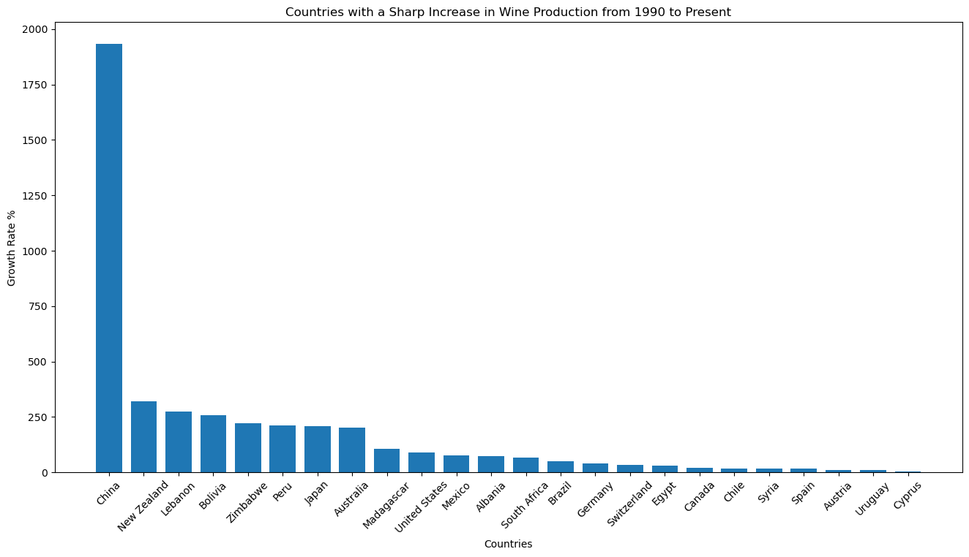
The Development of New Industry?
Notes:
One of the questions we wanted to ask was: are new wine industries developing given the rise in temperatures? Theoretically, there must be some regions where grape cultivation is now possible due in part to a warmer climate.
Unfortunately, after analyzing the data we collected, the answer to that question is inconclusive, as the data we collected tells only a very small part of the story.
But, given our limited data set, we decided to approach this question by finding countries that had recently experienced an uptick in their wine industry starting in 1990.
As we can see here, clearly, China is seeing a massive boom in their wine industry with a 1935% growth in their wine production. They are an outlier in the dataset, however, so we’ll look at the other
(NEXT SLIDE)

Slide 12
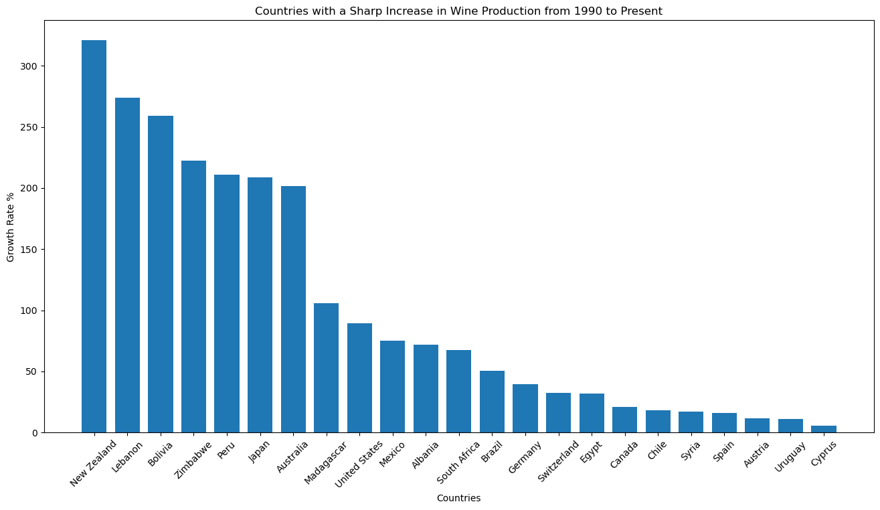
Notes:
Here is a cleaned up version of the data
So, by generating a list of countries experiencing a boom in their industry, we were able to compare those metrics against the weather metrics we had collected, mainly: the change in the country’s average temperature over time, and the correlation of average temperature to wine production.
(NEXT SLIDE)
New Zealand(321.16%, r=.2972), Japan(208%, r=.5224), Australia(186.73%, r=.4793), Madagascar(105.58%, r=.46), South Africa, Brazil

Slide 13
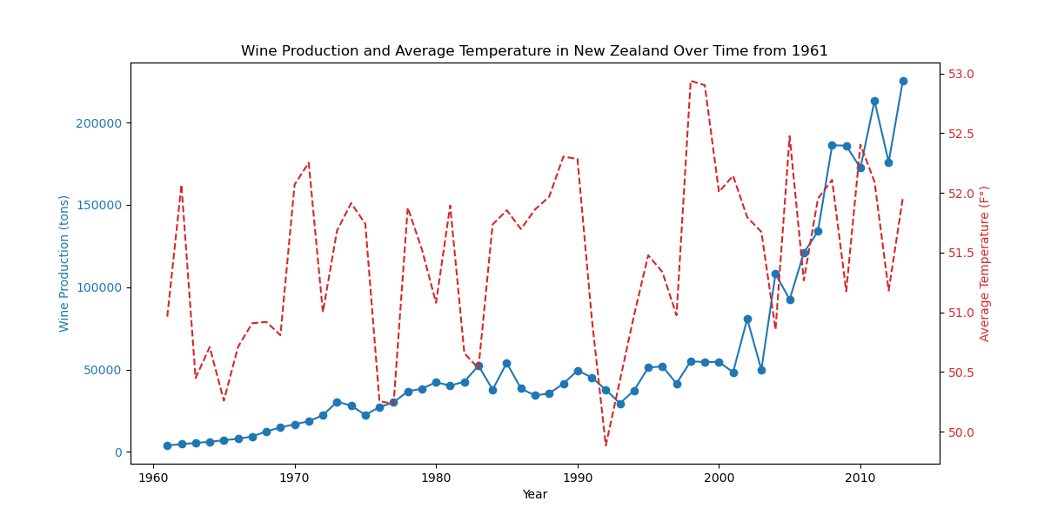
New Zealand Wine Production from 1961
Notes:
Here is New Zealand, for example, the country experiencing the largest boom in its wine industry (except for China, of course).
Since 1990, New Zealand has seen a 321.16% uptick in its wine production.
And as we can see, from about 1993 onward, there is a significant upward trend in wine production.
The red line here is representing the change in average temperature over time, and from this perspective, it may be difficult to see if there is in fact an upward trend in temperature.
(NEXT SLIDE)

Slide 14
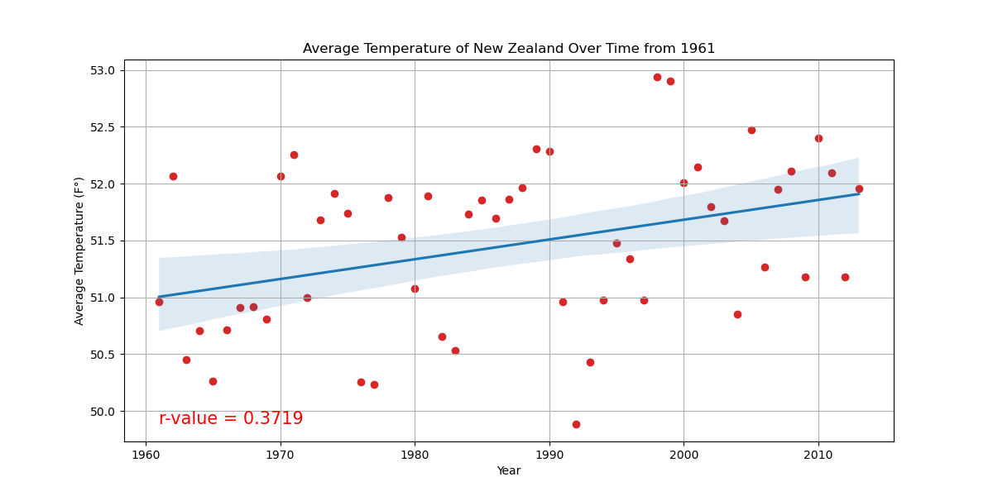
New Zealand Temperature over time from 1961
Notes:
When we take a look at JUST the average temperature over time, we see that there is a weak, approaching moderate correlation between temperature rise and year of .37.
At this point, we might be able to say that MAYBE, there is a weak correlation.
(NEXT SLIDE)

Slide 15
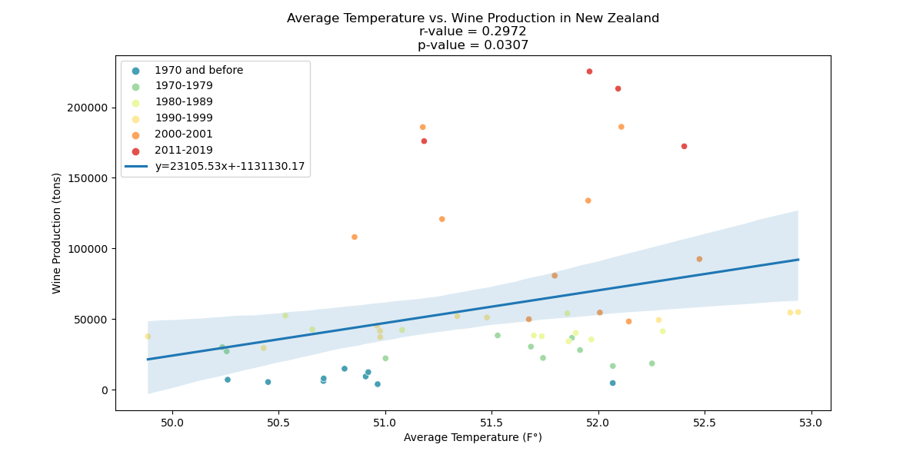
New Zealand Wine Production vs. Avg. Temp. 1961
Notes:
But now when we look at the correlation between wine production and average temperature, we see that there is essentially no significant correlation between higher temperatures and wine production
Thus, it might be safe to say that higher temperatures are NOT having a significant effect on New Zealand's wine production.

Slide 16
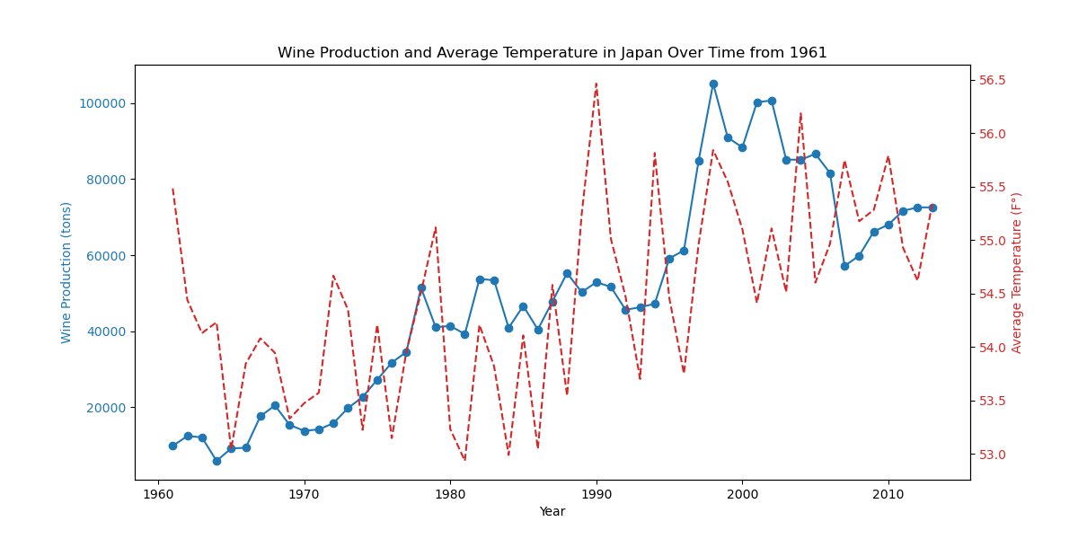
Japan Wine Production from 1961
r=.8820
Notes:
If we look at a country like Japan, however, we begin to see some significant data
From 1990 onwards, we see a an upward trend in wine production, and an overall r-value of .8820, indicating a strong statistical significance in the production of wine over time.
The average temperature also appears to be rising, and if we expand on that information
(NEXT SLIDE)

Slide 17
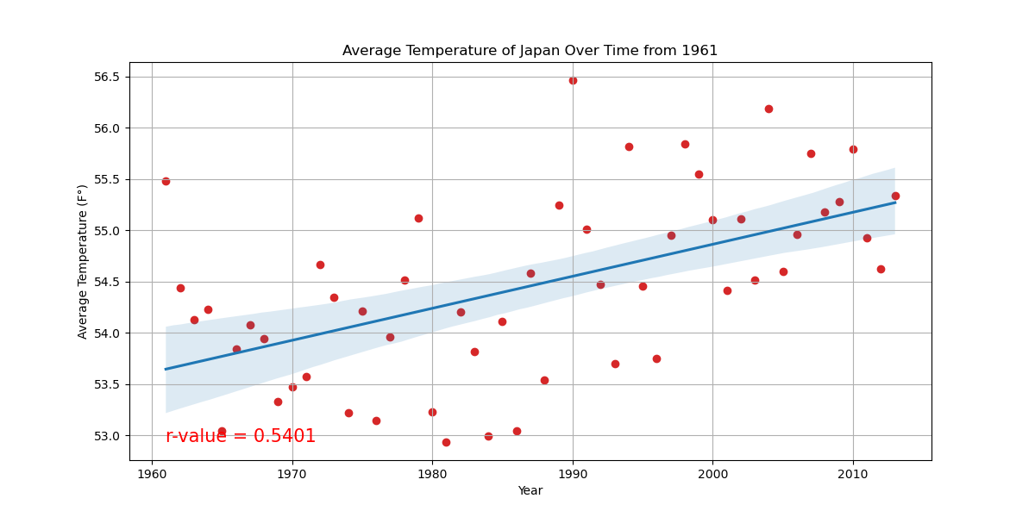
Japan Temperature over time from 1961
Notes:
We see that the temperature over time is in fact on the rise, with a moderate r-value of .5401
(NEXT SLIDE)

Slide 18
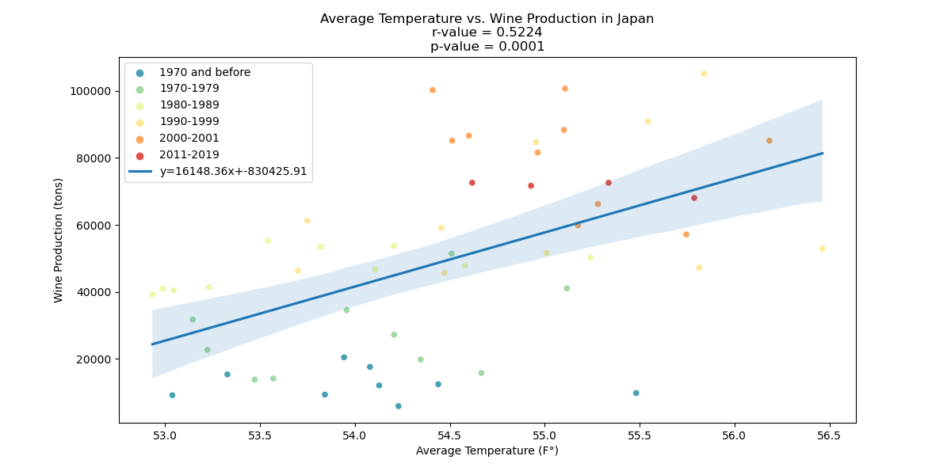
Japan Wine Production vs. Avg. Temp. from 1961
Notes:
If we now check how higher average temperature affects wine production, we see that higher temperatures are correlated to higher wine production with a moderate r-value of .5224.
But does this meant that we can draw a correlation between rising temperatures and wine production?
NO, unfortunately.
As we learned in class, correlation does not necessarily mean causation, and there are a wide variety of causations behind the production of wine. We did not account for market trends, domestic demand, culinary trends etc.
With this in mind, we can’t definitively say that Japan, or any of these countries experiencing an uptick in wine production, are caused by rising temperatures.

Slide 19
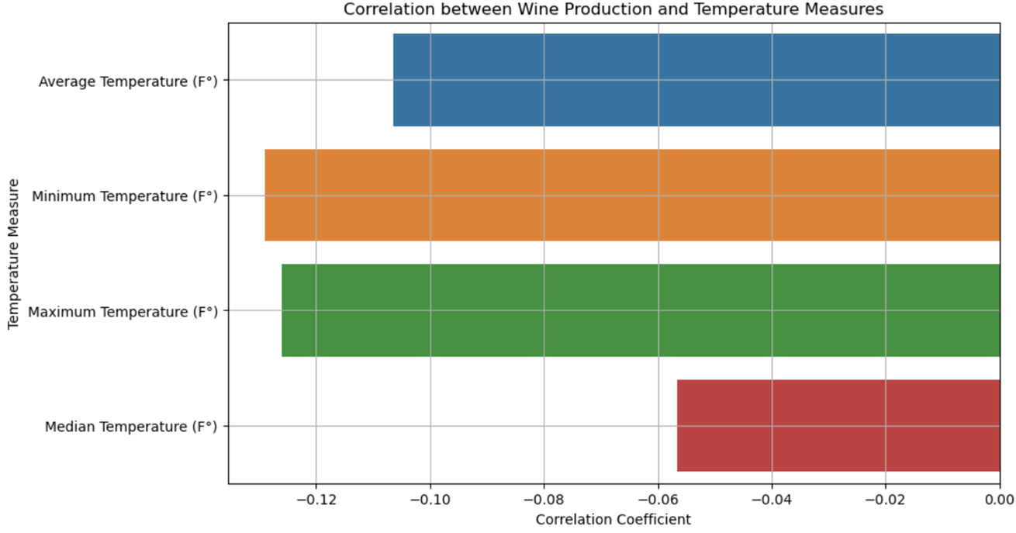
Correlation between Wine Production and Temperature Measures
+ 1 indicates a strong positive correlation.
- 1 indicates a strong negative correlation.
Notes:
Research question: whether certain regions will see difference in wine production with temperature change in the future and can we predict it with our data?
Here we are looking at the correlation between wine production and temperature measures.
These are values are between -1 and 1 that measure the strength and direction of the relationship between two variables.
A coefficient close to 1 is a strong positive correlation.
This means as temperatures increase, wine production increases too.
A coefficient close to -1 indicates a strong negative correlation. This means as one temperatures increases, the wine production decreases.
A coefficient around 0 suggests a weak or no linear correlation between the variables.
This bar chart shows the median temperature vs. wine production shows very weak correlation.

Slide 20
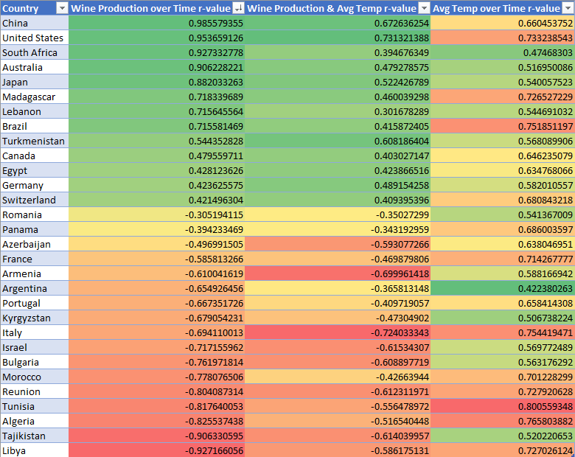
Notes:
To find statistically significant countries, we collected r-values and p-values for wine production, temperature over time, and wine production vs average temperature for each country.
We then filtered out all countries that were not statistically significant.
There IS correlation between wine production and temperature changes, but these numbers are not an indication that there is a causation.

Slide 21
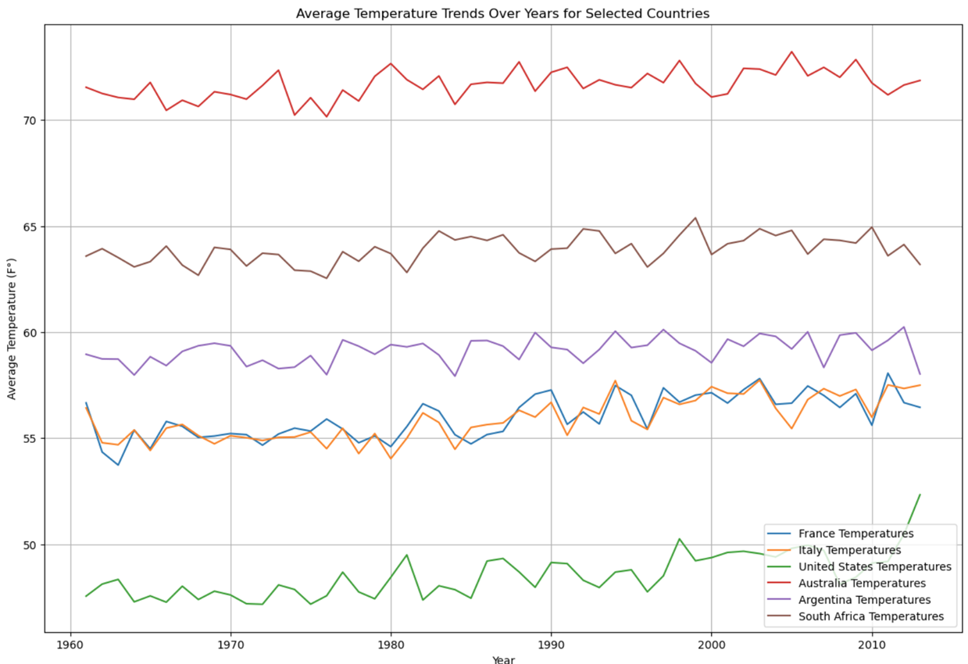
Average Temperature Trends Over Years for Selected Countries
Notes:
Why we chose these countries? Countries with most wine production for best data accuracy. If climate change affects wine production, countries with most wine production in volume would show this change.
And we wanted to pick countries from as varied locations on the earth as possible. This way we not only see trends in different continents, but also changes specifically in different climate type zones such as temperate climates vs. arid temperatures etc.
This chart shows how the average temperature has changed over the years in each selected country. A general upward trend in temperature would indicate regions that are experiencing warming, which could affect wine production.
By examining how both average temperature and wine production have changed over time, we can identify long-term patterns and trends.
This analysis provides insights into whether rising temperatures are associated with increasing or decreasing wine production and helps to predict future trends.

Slide 22
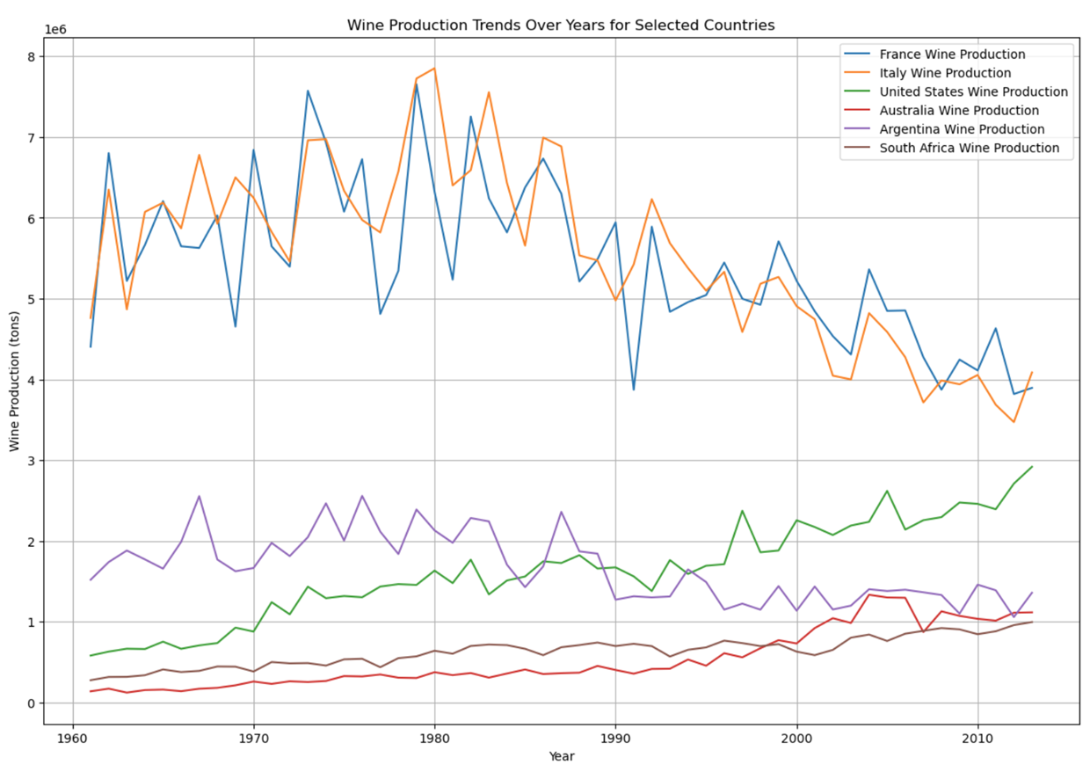
Wine Production Trends Over Years for Selected Countries
Notes:
This chart illustrates the wine production in tons over the years for the same set of countries. Temperature trends changes here can show how wine production has been impacted by changes in temperature.

Slide 23
Conclusion - Results
Varied Impact Across Regions:
Climate change impact on wine production varies significantly across different regions.
France, Italy, the United States, Australia, Argentina, and South Africa show differing trends in temperature changes vs. wine production.
Temperature-Wine Production Relationship:
Temperature fluctuations are related to changes in wine production BUT relationship's strength and direction vary by region.
Some exhibit comparably a more positive correlation, suggesting increased wine production with rising temperatures, while others show a more negative correlation, indicating a potential decrease in production.
Notes:
Overview: Temperature changes do influence wine production, but the extent and nature of this impact vary.
Positive Correlation: Rising temperatures have coincided with increased wine production, possibly due to extended growing seasons or other factors.
Negative Correlation: Increased temperatures have led to reduced production, perhaps due to heat stress on vines or water scarcity.
Caution: Correlation doesn't imply causation and that other variables might also play significant roles.

Slide 24
Conclusion Limitations
Soil Type
Impact on grape growth of different soil types
Soil composition, drainage, and pH levels play crucial roles in viticulture
Adaptation to Climate Change
Resilience of certain soil types to climatic changes
Government Investment in the Wine Industry
Research and development:
Government funding on viticulture practices that improve resilience to climate change
Support policies
Subsidies, grants, and other forms of government support to help mitigate climate change effect
Water Availability
Water availability and irrigation practices
Pest and Disease Pressure
Distribution of pests and diseases that affect vineyards via new climate patterns
Technological Advancements
New technologies in wine production to help cope with climate change
Consumer Demand and Market Trends
Consumer preferences, global market dynamics

Slide 25
Citations
Global Temperature Anomaly Data
GISTEMP Team, 2023: GISS Surface Temperature Analysis (GISTEMP), version 4. NASA Goddard Institute for Space Studies. https://data.giss.nasa.gov/gistemp/.
Lenssen, N., G. Schmidt, J. Hansen, M. Menne, A. Persin, R. Ruedy, and D. Zyss, 2019: Improvements in the GISTEMP uncertainty model. J. Geophys. Res. Atmos., 124, no. 12, 6307-6326, doi:10.1029/2018JD029522.
Wine Production Data
Food and Agriculture Organization of the United Nations (FAO).License: CC BY-NC-SA 3.0 IGO. Production / Crops and livestock products - Metadata. March 24, 2023. Extracted from: https://www.fao.org/faostat/en/#data.
Temperature Data
Menne, Matthew J., Imke Durre, Bryant Korzeniewski, Shelley McNeill, Kristy Thomas, Xungang Yin, Steven Anthony, Ron Ray, Russell S. Vose, Byron E.Gleason, and Tamara G. Houston (2012): Global Historical Climatology Network - Daily (GHCN-Daily), Version 3.. NOAA National Climatic Data Center. doi:10.7289/V5D21VHZ.

